Slide 1
SPLENDOR INSURANCE ANALYTICS DASHBOARD
DATA INTERPRETATION

Slide 2
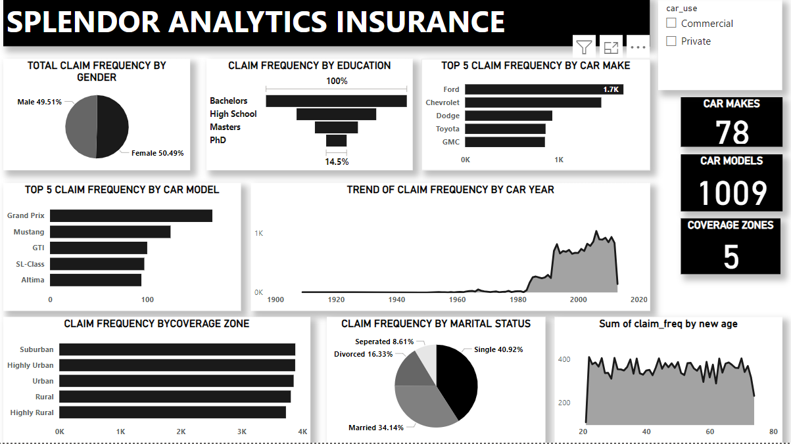
CLAIM FREQUENCY WITHOUT FILTERS

Slide 3
CLAIM FREQUENCY WITHOUT FILTERS
Without filters, we noticed the following;
Gender- Male scored a percentage total of 50.49% and female, a percentage total of 49.51% on the claim frequency pie chart.
Education- Bachelors has the largest claim frequency, followed by high school, then masters. PhD has the lowest claims frequency.
Car Makes- we looked into a chart of the top 5 car make in respect to claims frequency, Chevrolet leads, followed by ford, dodge, and Toyota, gmc holds 5th position
Car Model- Also looked into a chart of the top 5 car model in respect to claim frequency, Grand Prix leads followed by Mustang, GTI and SL-class, Altima holds 5th position.
Car Year- Cars made in 2006 scored highest in the trendline chart against claim frequency

Slide 4
CLAIM FREQUENCY WITHOUT FILTERS
Coverage Zone - Cars from sub-urban areas have the most claim frequency, highly urban, urban, rural, highly rural came 2nd,3rd, 4th and 5th respectively.
Marital Status - Single policy holders have the most claim frequency, then married, divorced and separated respectively.
Age - Policy holders with age 22 claimed the most.

Slide 5
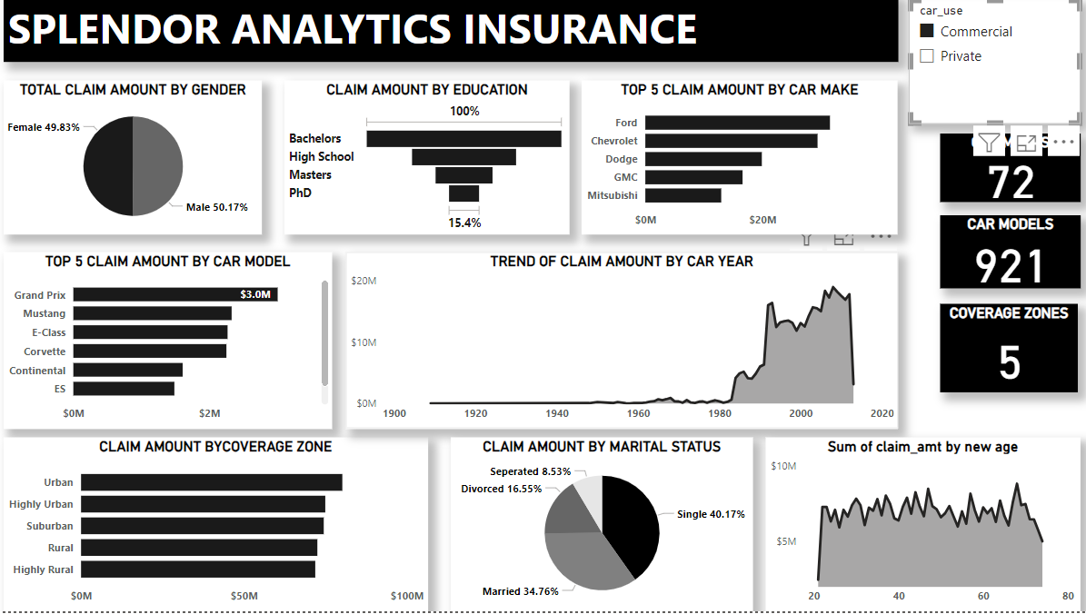
CLAIM FREQUENCY WITH FILTERS-COMMERCIAL VEHICLE USERS

Slide 6
CLAIM FREQUENCY WITH FILTERS-COMMERCIAL VEHICLE USERS
With commercial vehicle users filter, we noticed the following;
Gender- Male scored a percentage total of 51.57% and female, a percentage total of 48.43% on the claim frequency chart.
Education- Bachelors has the largest claim frequency, followed by high school, then masters. PhD has the lowest claims frequency.
Car Makes- we looked into a chart of the top 5 car make in respect to claims frequency, ford leads, followed by Chevrolet, dodge, gmc and Mitsubishi holds 5th position.
Car Model- Also looked into a chart of the top 5 car model in respect to claim frequency, Grand Prix leads followed by e-class, corvette and continental, es-class holds 5th position.
Car Year- Cars made in 2006 scored highest in the trendline chart against claim frequency

Slide 7
CLAIM FREQUENCY WITH FILTERS-COMMERCIAL VEHICLE USERS
Coverage Zone - Cars from urban areas have the most claim frequency, highly urban, sub-urban, rural, highly rural came 2nd,3rd, 4th and 5th respectively.
Marital Status - Single policy holders have the most claim frequency, then married, divorced and separated respectively.
Age - Policy holders with age 22 claimed the most.

Slide 8
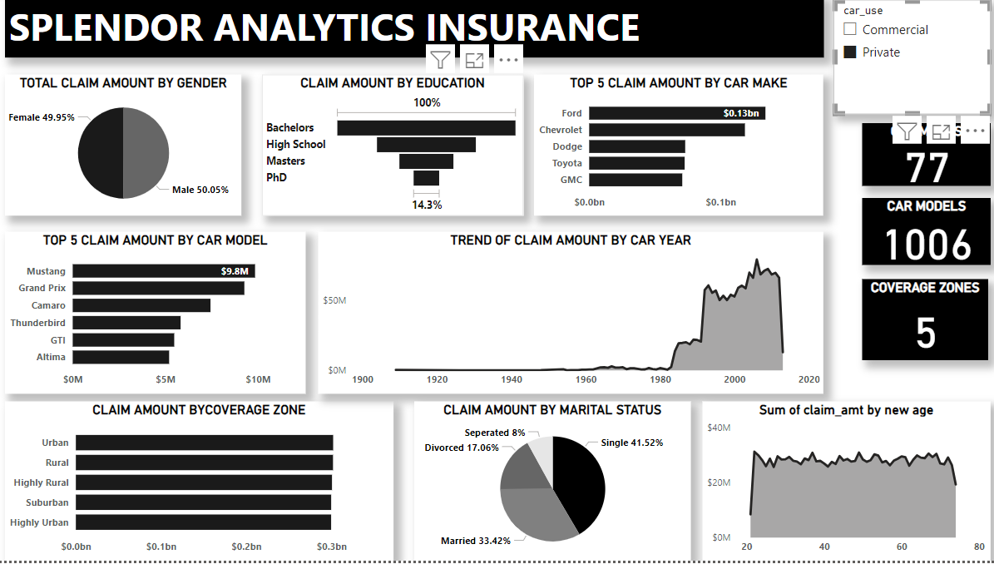
CLAIM FREQUENCY WITH FILTERS- PRIVATE VEHICLE USERS

Slide 9
CLAIM FREQUENCY WITH FILTERS- PRIVATE VEHICLE USERS
With Private vehicle users filter, we noticed the following;
Gender- Male scored a percentage total of 49.01% and female, a percentage total of 50.99% on the claim frequency chart.
Education- Bachelors has the largest claim frequency, followed by high school, then masters. PhD has the lowest claims frequency.
Car Makes- we looked into a chart of the top 5 car make in respect to claims frequency, ford leads, followed by Chevrolet, dodge and Toyota, GMC holds 5th position.
Car Model- Also looked into a chart of the top 5 car model in respect to claim frequency, Mustang leads followed by Grand prix, Camaro
Car Year- Cars made in 2006 scored highest in the trendline chart against claim frequency

Slide 10
CLAIM FREQUENCY WITH FILTERS- PRIVATE VEHICLE USERS
Coverage Zone - Cars from sub-urban areas have the most claim frequency, highly urban, urban, rural, highly rural came 2nd,3rd, 4th and 5th respectively.
Marital Status - Single policy holders have the most claim frequency, then married, divorced and separated respectively.
Age - Policy holders with age 30 claimed the most.

Slide 11
RISK ASSESSMENT
Gender-Without filters, female made the most claim. Commercial male car users made the most claim. Private female car users also come top with the most claim. But it should be noted that the differences are close to being insignificant. Therefore, can not be said to be a major determinant to high risk policy holders.
Education – Car users with Bachelors degree have the most claim in all- with and without filters. PhD has the least claim in all three
Marital Status- Unmarried car users have the highest claim while separated has the lowest in al three categories.
Common characteristics among high risk policy holders- single, holds bachelors degree

Slide 12
DEMOGRAPHIC ANALYSIS
Age- policy holders at 22y/o are high risk commercial users, age 30 are also very high risk private user.
Gender- evenly distributed with insignificant differences on all filters
Marital status- single people are high risk while separated policy holders are very low risk policy holders

Slide 13
GEOGRAPHICAL ANALYSIS
Without filters, policy holders staying in suburban zones are the highest risk as the make the most claim. Highly rural makes the least claim.
Commercial car users- policy holders staying in highly urban zones are the highest risk as the make the most claim. Suburban makes the least claim.
Private car users- policy holders staying in suburban zones are the highest risk as the make the most claim. Highly rural makes the least claim.

